Slide 1
Chapter : NoSQL
西电学堂 xt.xidian.edu.cn 搜索“数据库”

Slide 2
What is NoSQL...??
Non-relational database management systems,
Different from traditional RDBMS in some significant ways.

Slide 3
What is NoSQL...??
Core of NoSQL database_
  Hash Function – mathematical algorithm – take variable length of Input and produce a consistent, fixedlength Output.
  Key/Value pair is stored for later retrieval of record.

Slide 4
What is NoSQL...??
Designed for
  distributed data stores where
  very large scale of data storing needs
  (for example Google or Facebook which collects terabits of data every day for their users).

Slide 5
What is NoSQL...??
These type of data storing may not require fixed schema, avoid join operations and typically scale horizontally.

Slide 6
Scaling...!!!!
Ability of a System to expand to meet business needs.
Ex. Web application – allow more people to use web application
      Vertical Scaling
      Horizontal Scaling

Slide 7
Vertical Scaling...!!!!
Scale Up - add more resources within the same logical unit to increase capacity.
Ex. Add more CPUs / increase memory / add more hard drive

Slide 8
Horizontal Scaling...!!!!
Scale Out - add more nodes to system.
Ex. Add new computer to distributed software application.
In NoSQL system, data store can be much faster as it takes advantage of “scaling out”

Slide 9
Term NoSQL by Carlo Strozzi
Year 1998
NoSQL

Slide 10
Why is NoSQL?
NoSQL

Slide 11
Why NoSQL ?
In today’s time data is becoming easier to access and capture through third parties such as Facebook, Google+ and others.

Slide 12
Why NoSQL ?
Personal user information,
Social graphs,
Geo location data,
User-generated content and
Machine logging data
are just a few examples where the data has been increasing exponentially(指数级).

Slide 13
Why NoSQL ?
To avail the above service properly, it is required to process huge amount of data.
Which SQL databases were never designed. The evolution of NoSql databases is to handle these huge data properly.

Slide 14
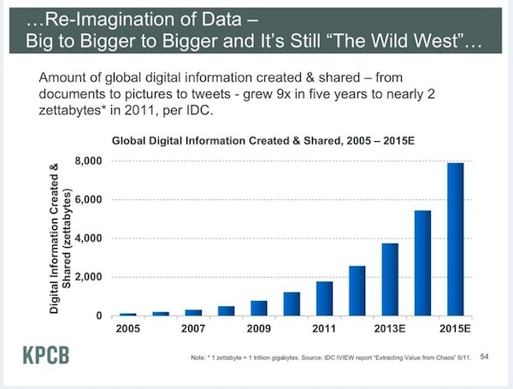

Slide 15
What’s there in NoSQL ?
Instead of using structured tables to store multiple related attributes in a row, NoSQL databases use the concept of a key/value store.

Slide 16
What’s there in NoSQL ?
No schema for the database.
Stores values for each provided key, distributes them across the database and then allows their efficient retrieval.

Slide 17
What’s there in NoSQL ?
Lack of a schema prevents complex queries and essentially prevents the use of NoSQL as a transactional database environment

Slide 18
RDBMS v/s NoSQL
Structured and organized data
Structured query language-SQL
Stands for Not Only SQL
No declarative query language
No predefined schema

Slide 19
RDBMS v/s NoSQL
Data and its relationships are stored in separate tables.
Data Manipulation Language, Data Definition Language
Key-Value pair storage, Column Store, Document Store, Graph databases
Eventual consistency rather ACID property

Slide 20
RDBMS v/s NoSQL
Tight Consistency
BASE Transaction
Unstructured and unpredictable data
CAP Theorem
Prioritizes high performance, high availability and scalability

Slide 21
CAP
Theorem
(Brewer’s Theorem)
NoSQL

Slide 22
CAP Theorem
When designing any distributed system. CAP theorem states that there are three basic requirements which exist in a special relation when designing applications for a distributed architecture.

Slide 23
CAP Theorem
Consistency - the data in the database remains consistent after the execution of an operation. For example after an update operation all clients see the same data.

Slide 24
CAP Theorem
Availability - the system is always on (service guarantee availability), no downtime.

Slide 25
CAP Theorem
Partition Tolerance - the system continues to function even the communication among the servers is unreliable, i.e. the servers may be partitioned into multiple groups that cannot communicate with one another.

Slide 26
CAP Theorem
In theoretically it is impossible to fulfill all 3 requirements
CAP provides the basic requirements for a distributed system to follow 2 of the 3 requirements

Slide 27
CAP Theorem
CA - Single site cluster, therefore all nodes are always in contact. When a partition occurs, the system blocks.
CP - Some data may not be accessible, but the rest is still consistent/accurate.
AP - System is still available under partitioning, but some of the data returned may be inaccurate.

Slide 28
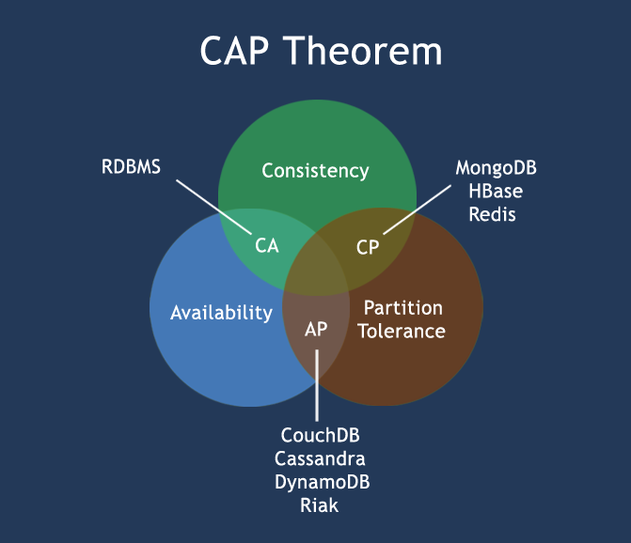

CAP Theorem

Slide 29
The BASE by Eric Brewer
NoSQL

Slide 30
The BASE
The CAP theorem states that a distributed computer system cannot guarantee all of the following three properties at the same time:
      Consistency
      Availability
      Partition tolerance

Slide 31
The BASE
A BASE system gives up on consistency.
Basically Available indicates that the system does guarantee availability, in terms of the CAP theorem.

Slide 32
The BASE
Soft state indicates that the state of the system may change over time, even without input. This is because of the eventual consistency model.

Slide 33
The BASE
Eventual consistency indicates that the system will become consistent over time, given that the system doesn't receive input during that time.

Slide 34
ACID v/s BASE
ACID BASE
Atomicity Basically Available
Consistency Soft state
Isolation Eventual consistency
Durable

Slide 35
Pros/Cons - NoSQL
Advantages
    High Scalability
    Distributed Computing
    Lower Cost
    Schema Flexibility
    Semi-Structured Data
    No Complicated Relationship

Slide 36
Pros/Cons - NoSQL
Disadvantages
    No Standardization
    Limited Query Capabilities
    Eventual Consistent is not intuitive to program for

Slide 37
Types of NoSQL
NoSQL

Slide 38
Categories of NoSQL database
1) Document Oriented:
Data is stored as documents. An example format may be like - FirstName="Arun", Address="St. Xavier's Road", Spouse=[{Name:"Kiran"}], Children=[{Name:"Rihit", Age:8}]

Slide 39

CouchDB, Jackrabbit, MongoDB, OrientDB, SimpleDB,Terrastore

Slide 40
Categories of NoSQL database
2) XML database:
Data is stored in XML format.
BaseX, eXist, MarkLogic Server etc.

Slide 41
Categories of NoSQL database
3) Graph databases:
Data is stored as a collection of nodes, where nodes are analogous to objects in a programming language. Nodes are connected using edges.

Slide 42

AllegroGraph, DEX, Neo4j,
FlockDB, Sones GraphDB

Slide 43
Categories of NoSQL database
4) Key-value store:
In Key-value-store category of NoSQL database, an user can store data in schema-less way. A key may be strings, hashes, lists, sets, sorted sets and values are stored against these keys.

Slide 44
Cassandra, Riak, Redis, memcached, BigTable etc.

Slide 45
Production deployment
There is a large number of companies using NoSQL.
Google, Facebook, Mozilla, Adobe, Foursquare, LinkedIn, Digg, McGraw-Hill Education, Vermont Public Radio

Slide 46
End of Chapter 16

